Slide 1

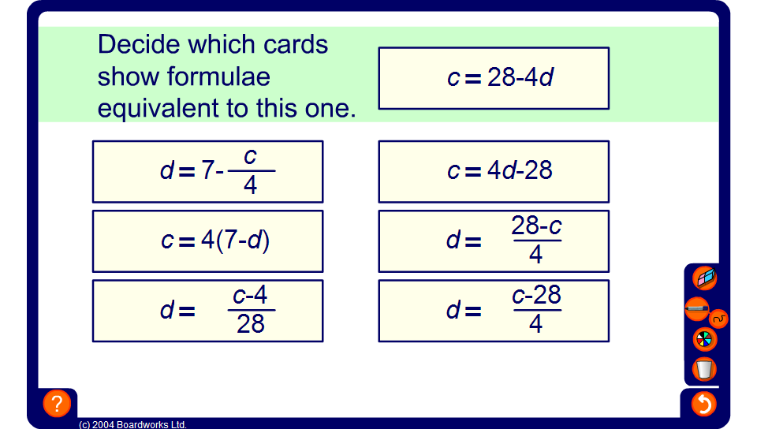


Equivalent formulae
Notes:
The aim of this activity is to correctly identify four equivalent forms of the same function.
The correct function appears in four different forms. An example,
c = 36 – 9d and d = ^{36 –} ^{c}/₉
c = 9(4 – d) and d = 4 – ^{c}/₉
Equivalent formulae can be found by rearranging the given formula, factorising or dividing.
If required ask pupils to find just one of the equivalent formulae. For example, ask pupils to find the formula which gives the other variable as the subject.
Pressing the reset button will generate a new set of equivalent formulae.

